Slide 1

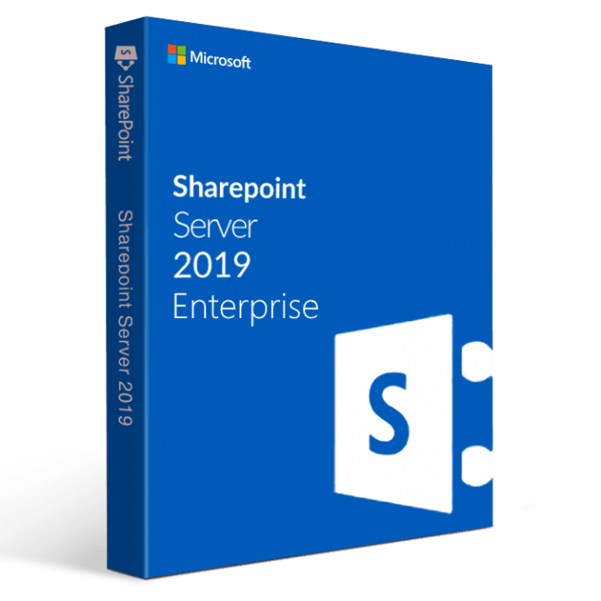

Enterprise template in SharePoint presented by- karamvir kaur agam kumar raiez raphe kartik velede

Slide 2
“Enterprise templates are used for create sites for managing enterprise content , data sharing and to serve management needs”
Enterprise templates-
Document Center
Records Center
Business Intelligence Center
Enterprise Search Center
Basic Search Center
Visio Process Repository

Slide 3
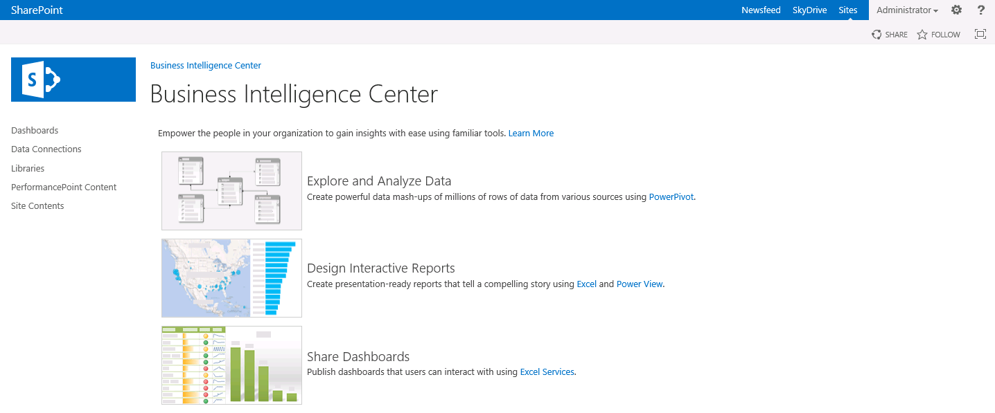
Business intelligence center
This site template is used to create sites for viewing and analyzing business intelligence data, including KPIs, reports, and analytics.

Slide 4
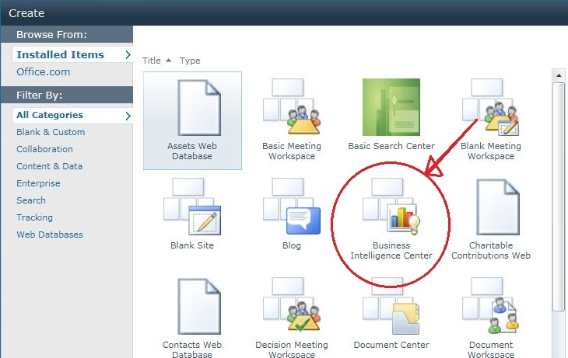
The Business Intelligence Center is a pre-built Web site, or site template
This template is optimized to help you manage the working elements of business intelligence (BI) reporting: scorecards, dashboards, data connections, status lists, status indicators

Slide 5
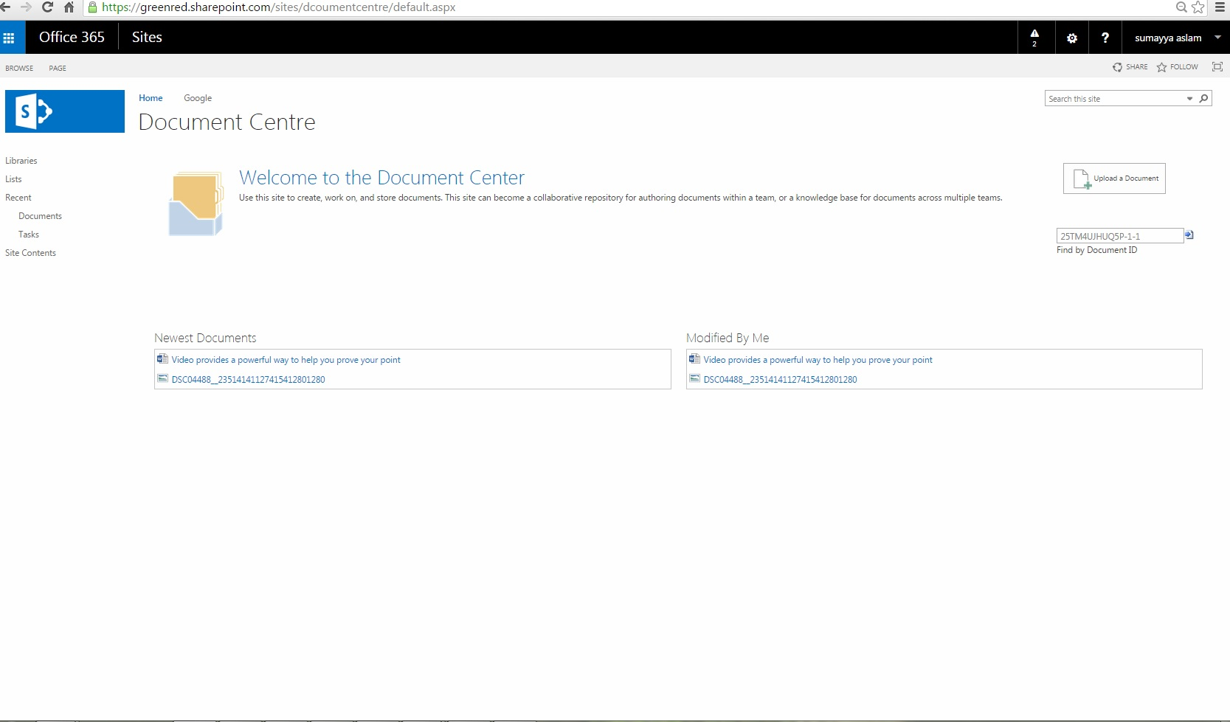
Document center
SharePoint offers a scalable, feature-rich experience for managing content
a large volume of files to manage, consider using a Document Center site template
the template is optimized for large-scale document management save time and help you be more efficient
Versions, document IDs, document sets, metadata navigation, and content types are included with the template.
A Document Center site works for both scenarios:
1. Authoring environment . 2. Content archive

Slide 6
Search center
The Search Center is a classic search experience
The Search Center is a site or site collection that has a starting page where users enter search queries and a search results page where users can drill into and refine search results or run a new query.
Two types of search: Basic Search Center and The Enterprise Search Center.
The main difference is that the Enterprise Search Center comes with the search verticals People, Conversations, and Videos. (Search verticals are pages that are tailored for displaying search results that are filtered and formatted for a specific content type or class)
More options for tailoring the look and feel of the Enterprise Search Center By default, SharePoint is set up with the Basic Search Center

Slide 7
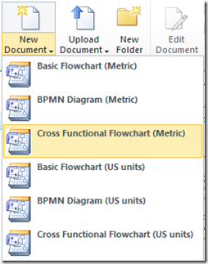
Visio Process Repository
Part of Enterprises Template group.
Used for sharing, viewing, and storing Visio process diagrams
Visio Process Repository has in-built file access control and version control
Repository also ensures that a user is working on most recent version of process diagram.
It also allow analysts to analyze database dependencies and data associated with processes.

Slide 8
Business example
Use of process repositories allows to make changes in multiple places. For example,
In a company a Project Manager role is changed to Business Analyst. Now, this change can easily be seen in all process diagrams where Project Manager appears without the need to update all those instances manually where the role appears.
This saves time and also reflects the efficiency of Process Repository.

Slide 9
Enterprise Search center
SEARCH CENTER SITE IN SHAREPOINT PROVIDES INTERFACE FOR USERS TO SUBMIT SERACH QUERIES AND GET SEARCH RESULTS.
A SEARCH CENTER SITE IS TYPICALLY A TOP-LEVEL SITE COLLECTION THAT PROVIDES CENTRAL SEARCH FACILITY.
In enterprise search center you can create your site pages .
Enterprise search finds the information that's most relevant to an organization's customers, employees, and partners. Enterprise search empowers them to take action and drive business outcomes.
Enterprise search includes welcome page with a search box that connects users to four search result pages experience, one for general ,people, conversation and video search. You can add and customize new results pages to focus on other type of search queries.

Slide 10
Business example
Building a corporate directory with SharePoint search center
A corporate directory is people company phone book to quickly find someone using whatever filter you want
To make sure the people data are available and searchable .the following are some of the properties you would like to show or allow users to filter and search by.
Name
Department
Email
Phone
Location
Job title

Slide 11
References
https://support.office.com/en-us/article/Getting-Started-Introduction-to-the-Business-Intelligence-Center-2EA9253A-5B61-4065-B6E3-7A981BB8D90D
SharePoint 2016 User's Guide: Learning Microsoft's Business Collaboration Platform, Fifth Edition / Smith, Tony.
https://docs.microsoft.com/en-us/sharepoint/search/create-a-search-center-site

